Slide 1

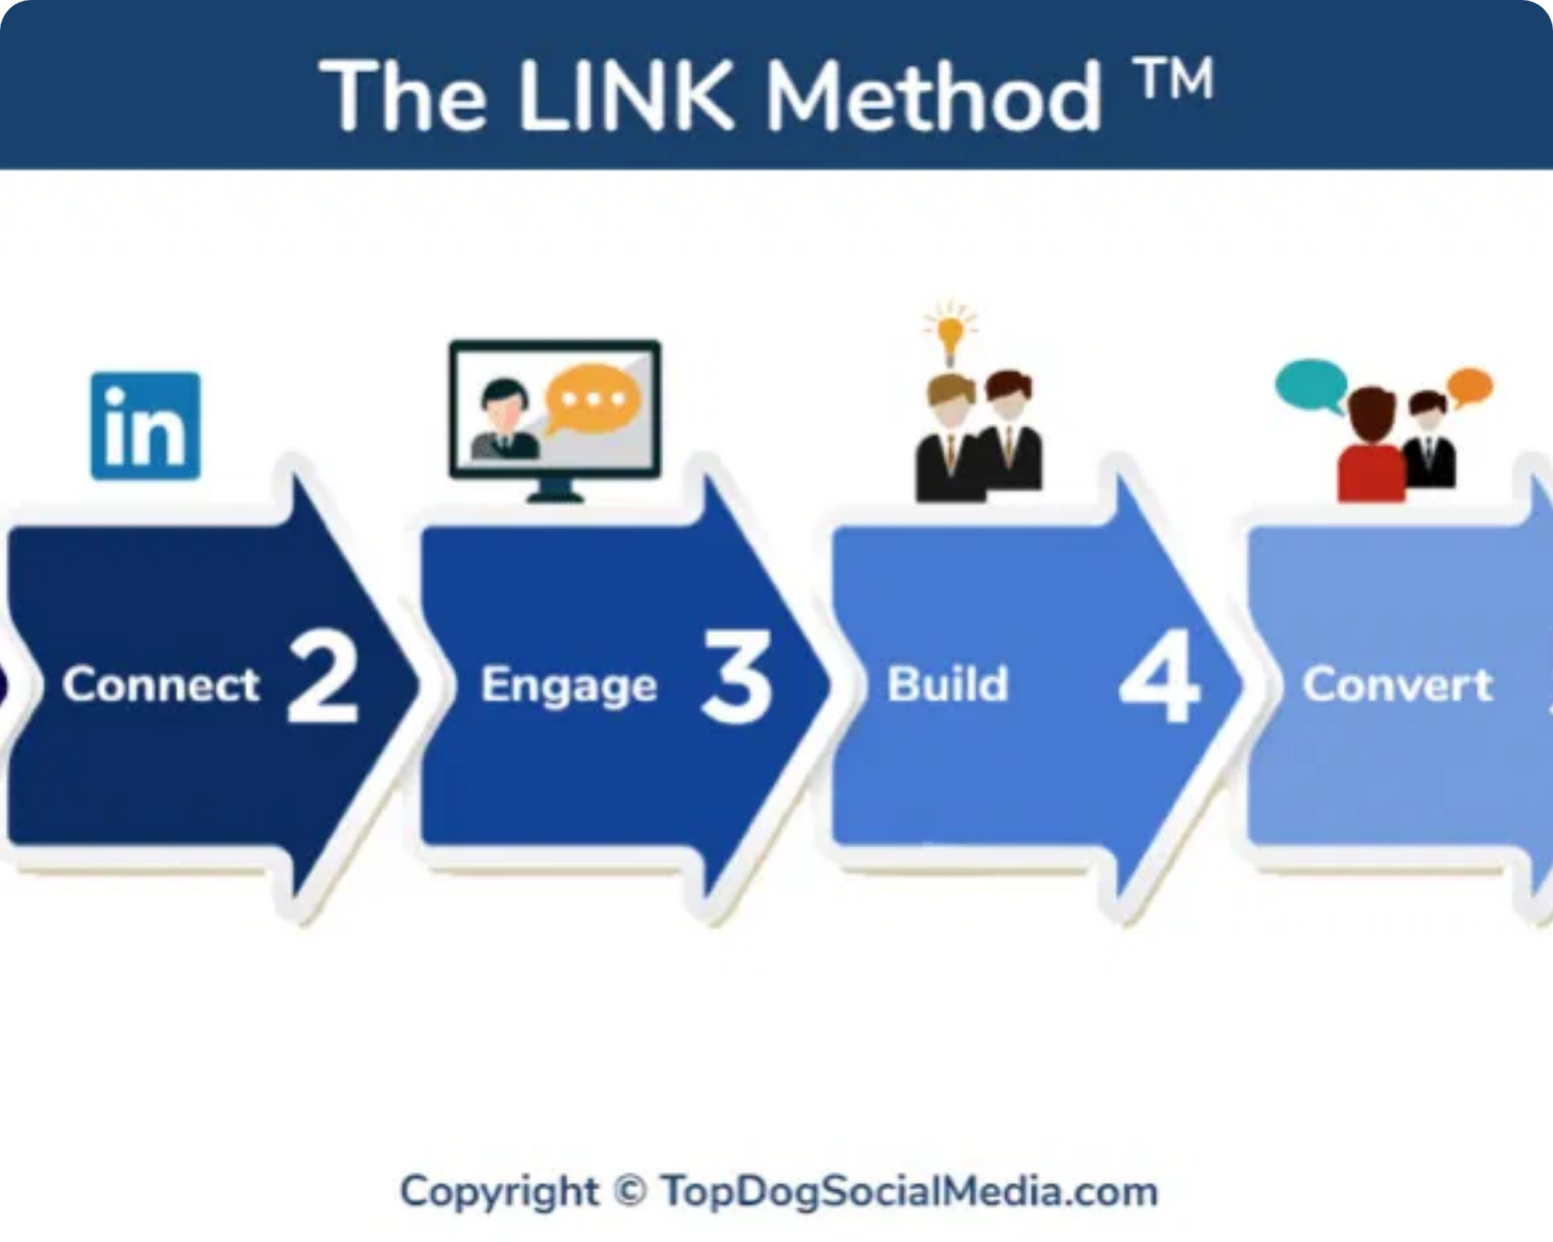
The Role of LinkedIn in Prospecting
Strategies for Modern Salespeople
Practical Training for Immediate Results

Slide 2

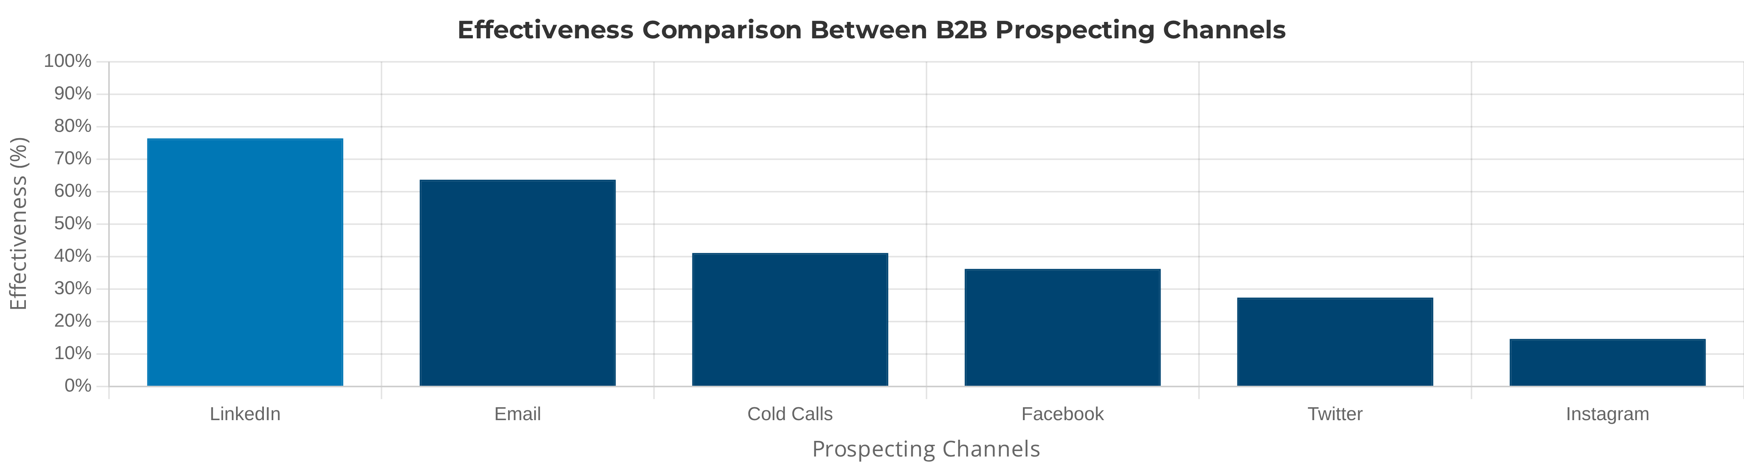
The Current B2B Prospecting Landscape
Why LinkedIn has become indispensable
80%
61%
45%
of B2B leads come from social media, with LinkedIn leading
of sales professionals report that LinkedIn generates more leads than other platforms
higher chance of closing deals through LinkedIn connections
LinkedIn is not just another channel - it's the epicenter of modern B2B prospecting

Slide 3

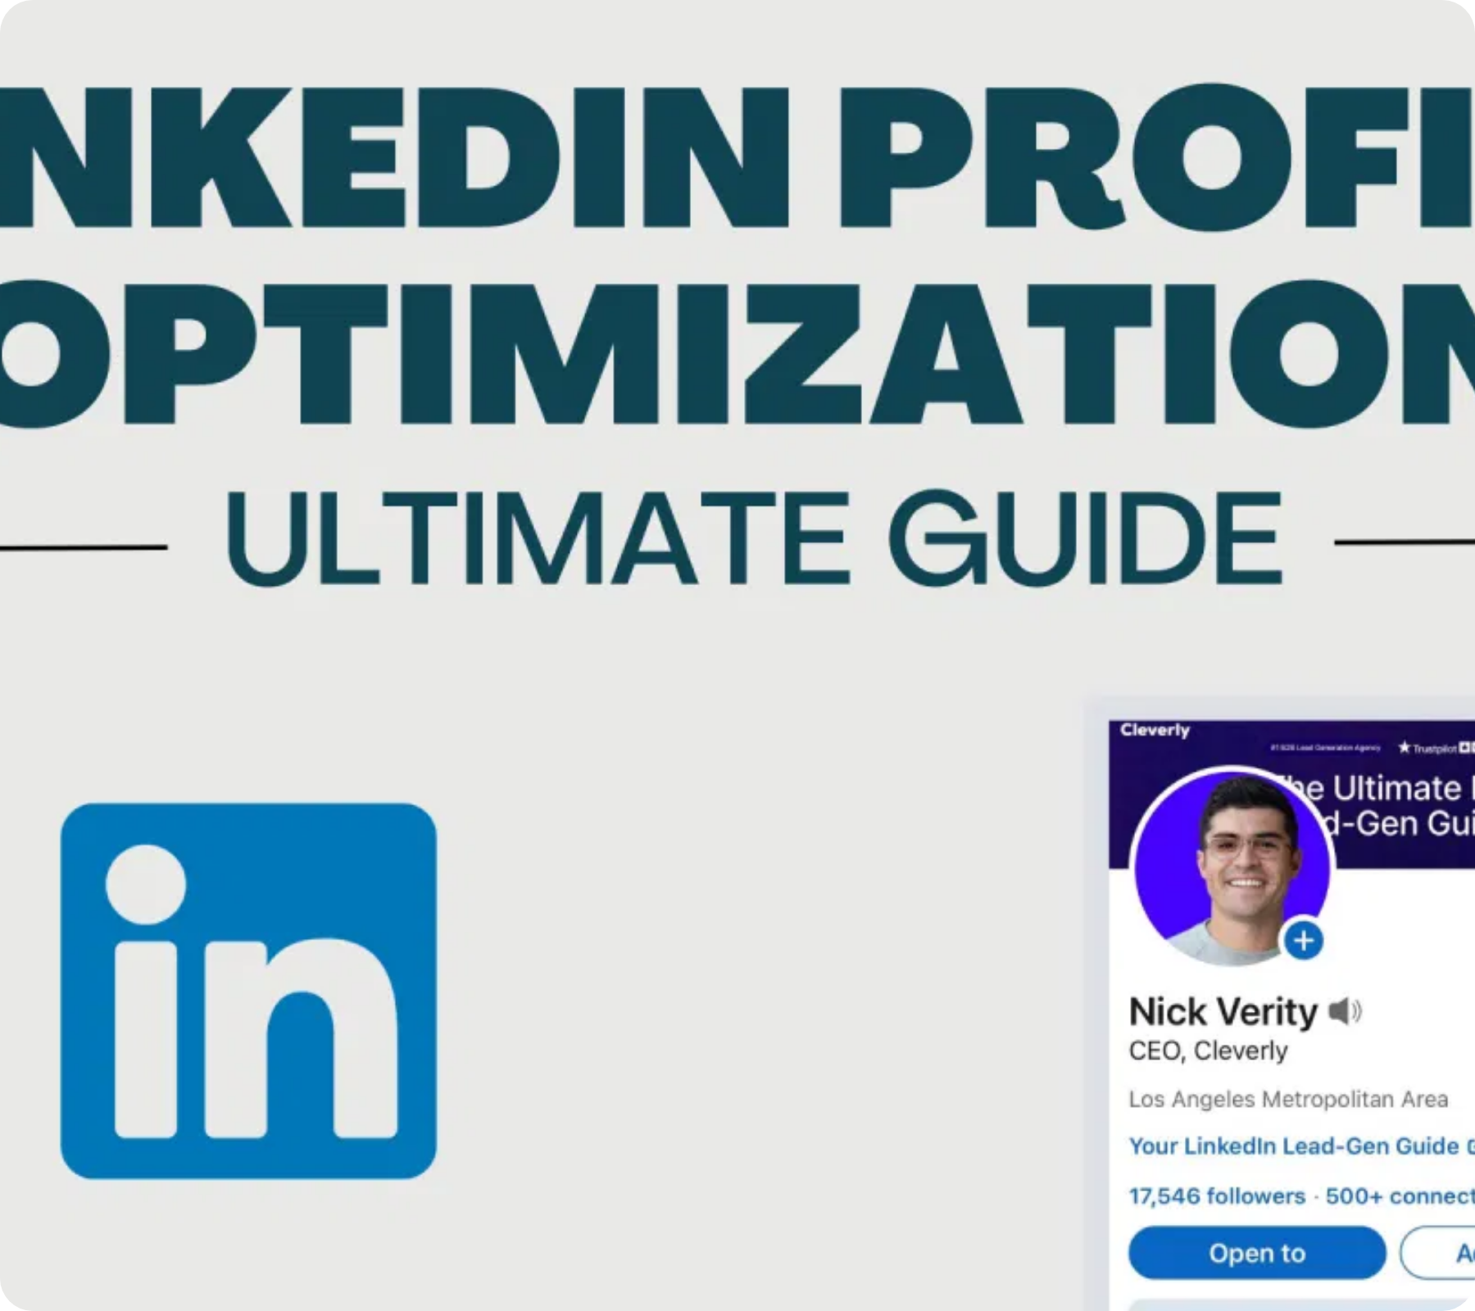
Building a Sales-Optimized Profile
Elements that build credibility
1
Professional Photo
21x increase in profile views. Use neutral background and friendly expression.
2
Value-Oriented Headline
E.g., "Helping tech companies increase sales by 30% with outbound strategies."
3
Results-Focused Summary
Highlight concrete results and include a clear call-to-action.
4
Quantified Experiences
E.g., "Increased client base by 45% in 6 months."

Slide 4

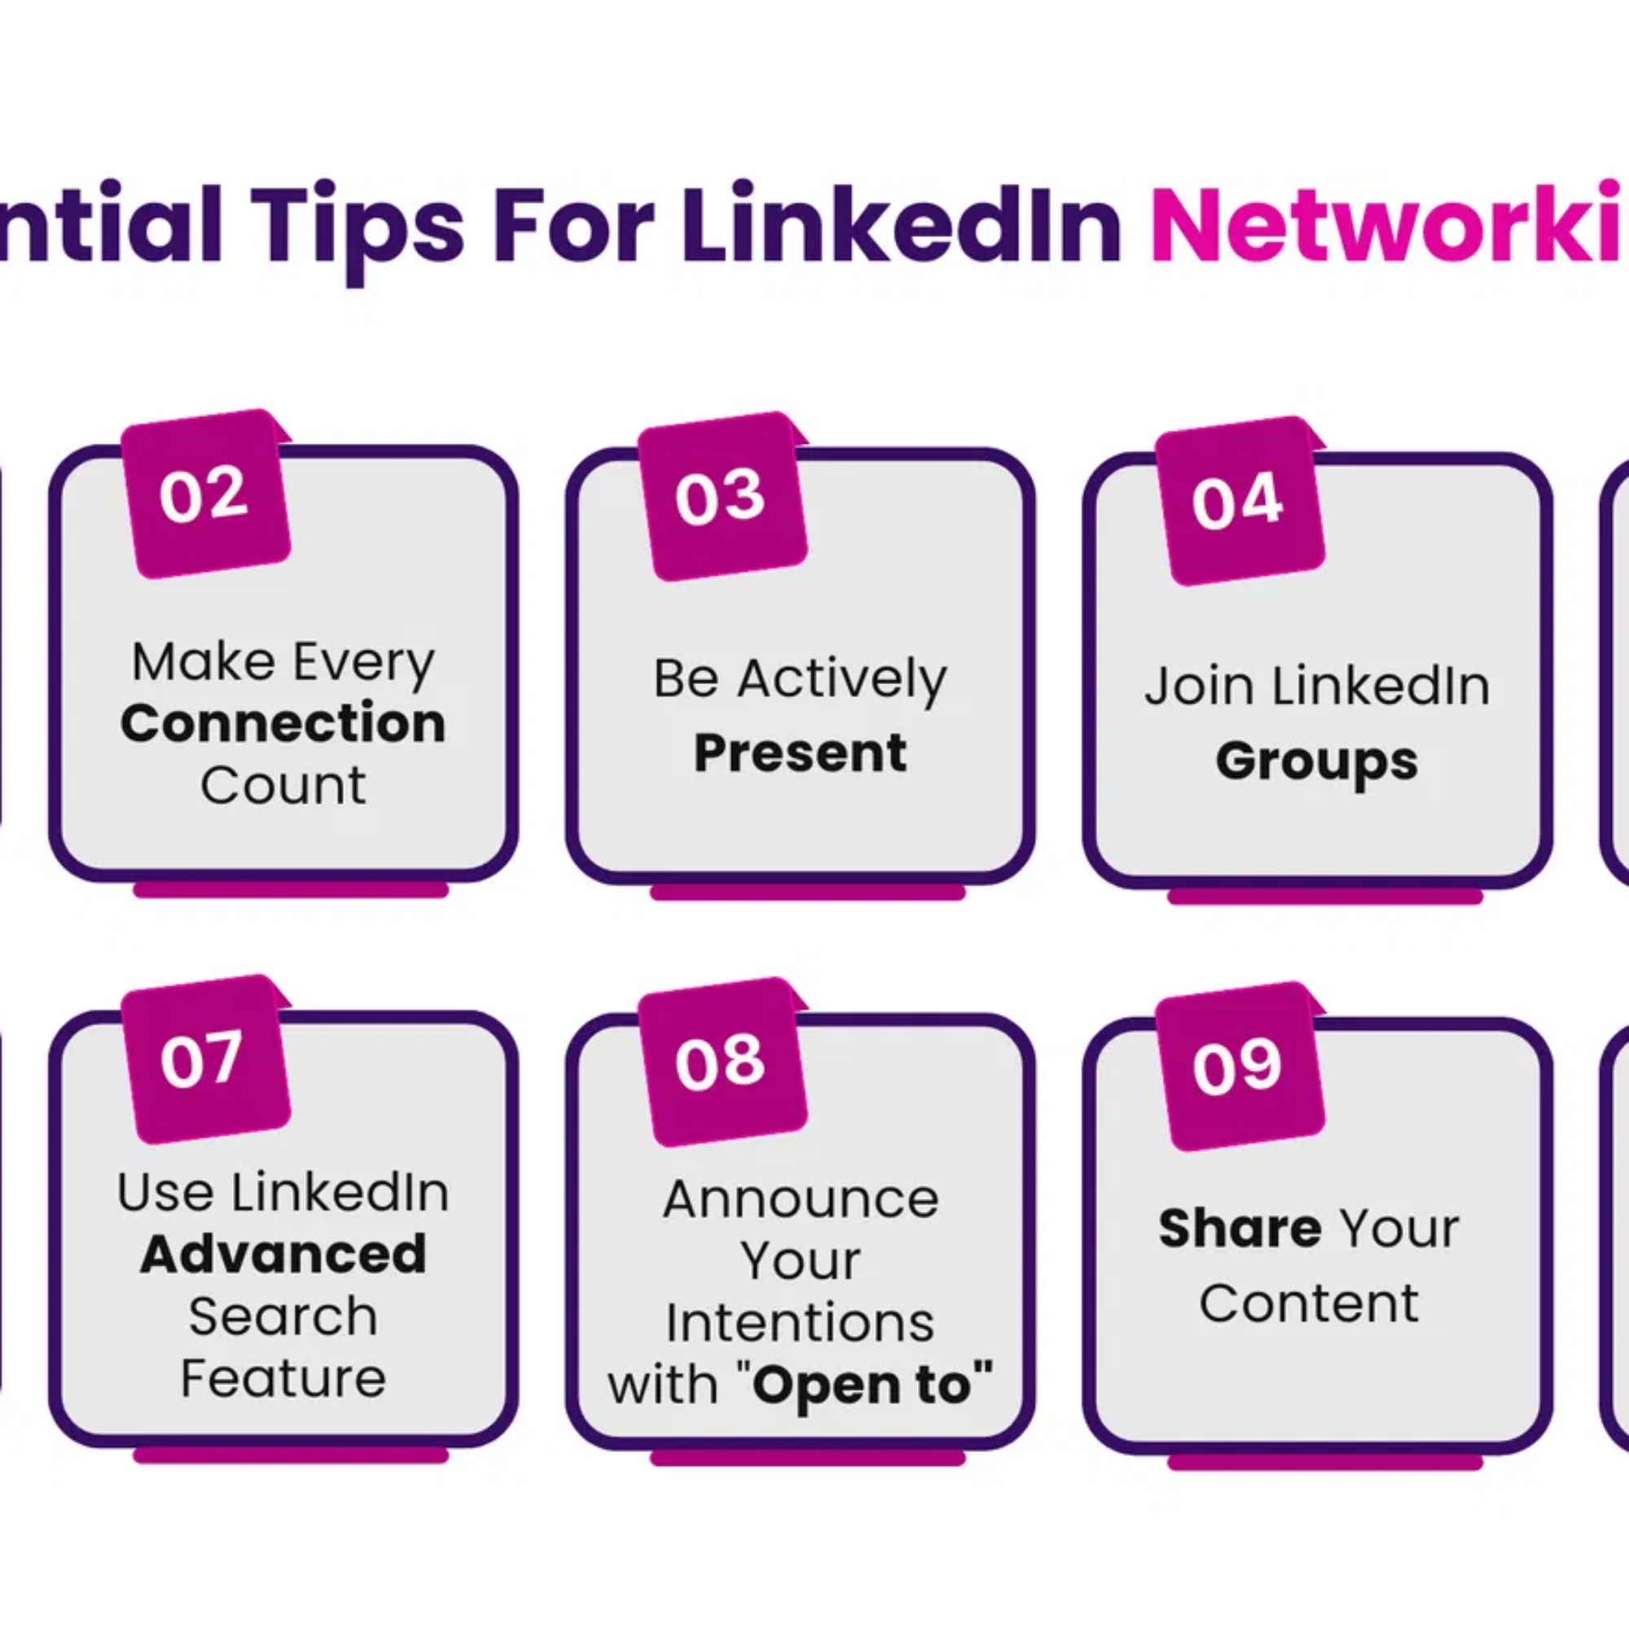
Qualified Connection Strategy
How to identify and connect with ideal prospects
1
Define Your ICP (Ideal Customer Profile)
Establish clear criteria: job title, industry, company size, location, and specific challenges your solution addresses.
2
Use Advanced Search Filters
Combine job title, company, industry, and location filters to find prospects that match your ICP.
3
Identify Mutual Connections
Prioritize prospects with mutual connections and ask for introductions when appropriate. Increases acceptance rate by up to 3x.
4
Engage Before Connecting
Comment on posts, join the same groups, or follow the prospect's company before sending a connection request.
5
Personalize Each Request
Mention common interests, content you both follow, or the specific reason for connecting. Avoid generic templates.

Slide 5

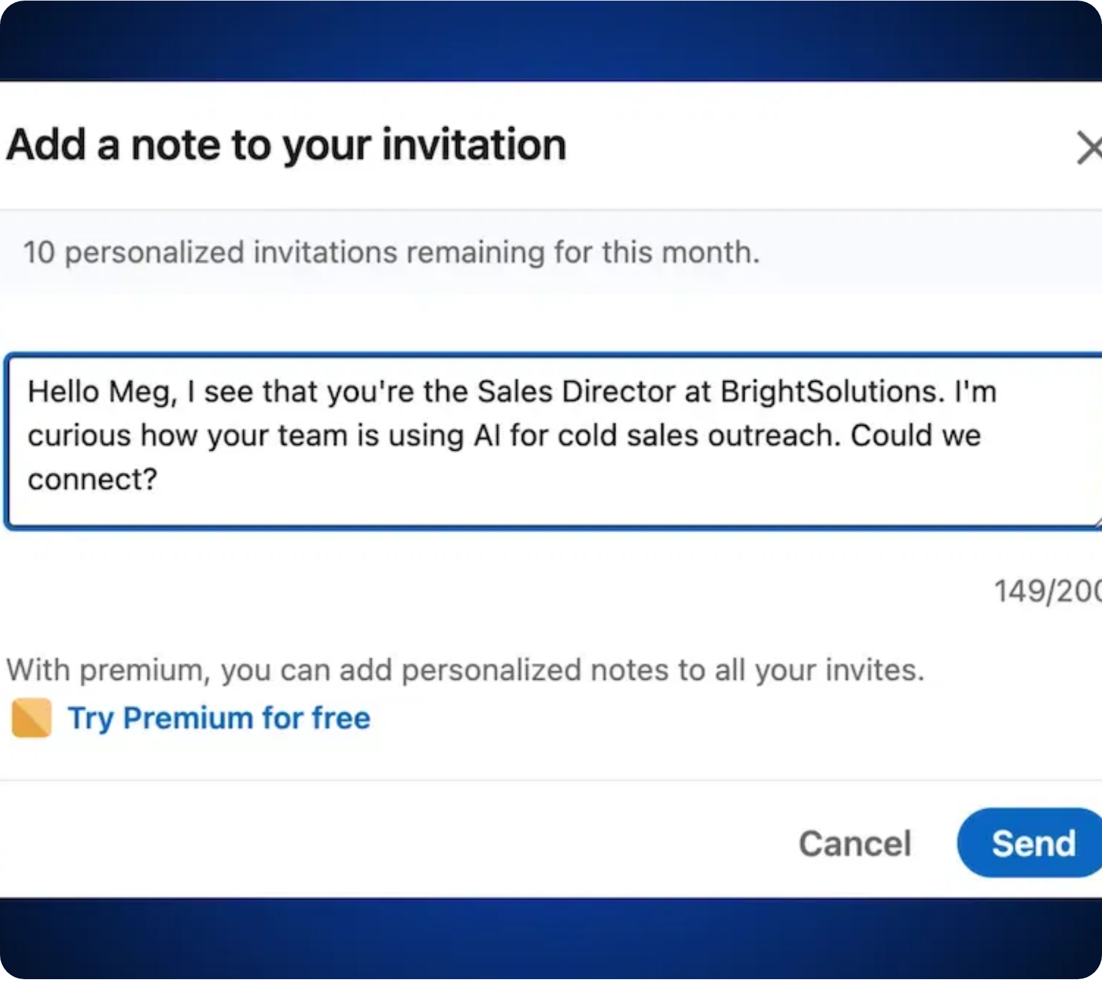




The Initial Approach That Works
Techniques for first contact that generate responses
Research first:
Mention something specific from their
profile or company
Be relevant:
Connect to the prospect's current moment
Ask a question:
Encourage response with a specific
question
Be concise:
Limit to 300 characters (2-3 short sentences)
EFFECTIVE
"Hi Sarah, I read your article on digital transformation in financial services. Your approach to process automation aligns with what we've been doing at XYZ. Would you be open to exchanging ideas about how we're solving legacy system integration challenges?"
INEFFECTIVE
"Hello, I'm a representative from XYZ company and we offer digital transformation solutions. We have the best prices in the market and would like to schedule a demo to show how we can help your company. When are you available?"

Slide 6
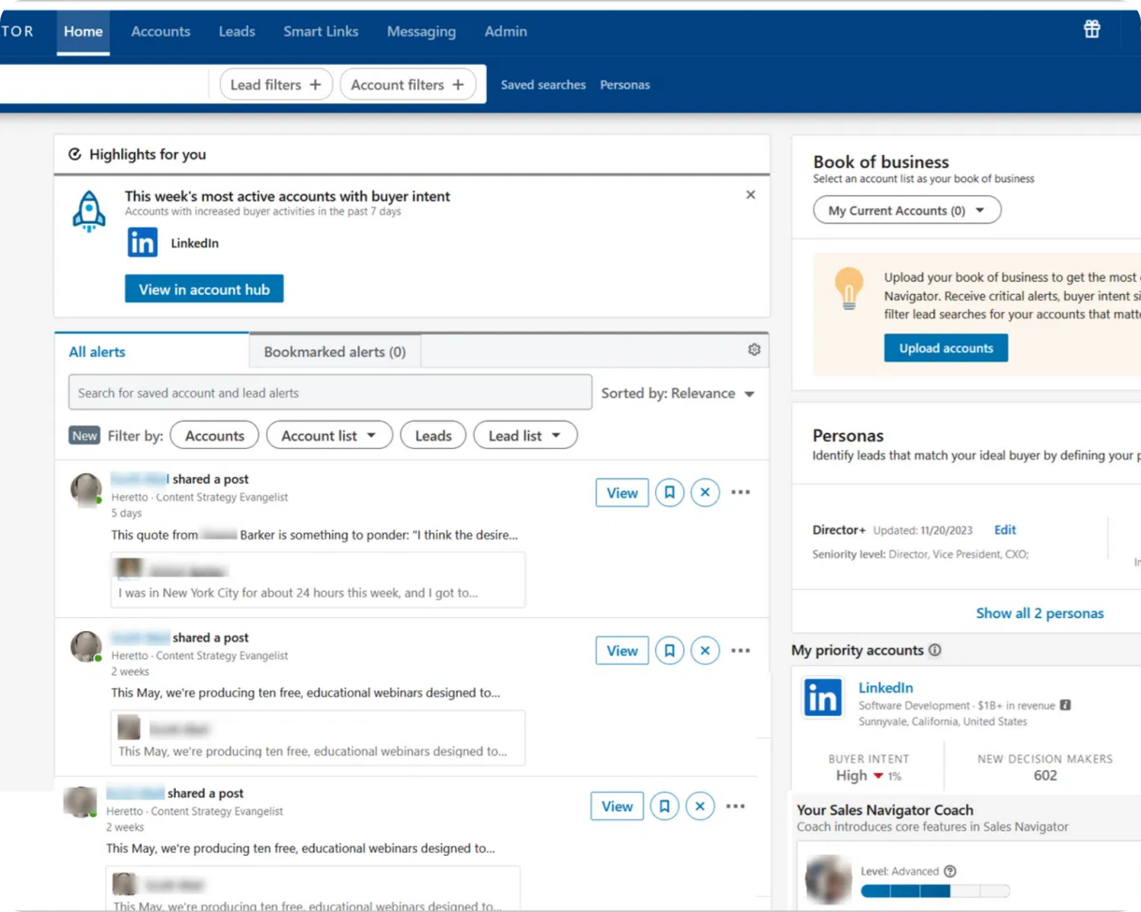





Mastering Sales Navigator
Advanced tools for effective prospecting
Advanced Search
Specific filters by job title, industry, company size, growth, and more.
Saved Leads
Organize prospects into custom lists and receive alerts about profile changes.
Custom Alerts
Notifications about job changes, work anniversaries, and other contact opportunities.
Company Insights
Data on growth, hiring, and organizational changes to identify ideal approach timing.
TeamLink
Discover mutual connections with your team to facilitate introductions and referrals.

Slide 7







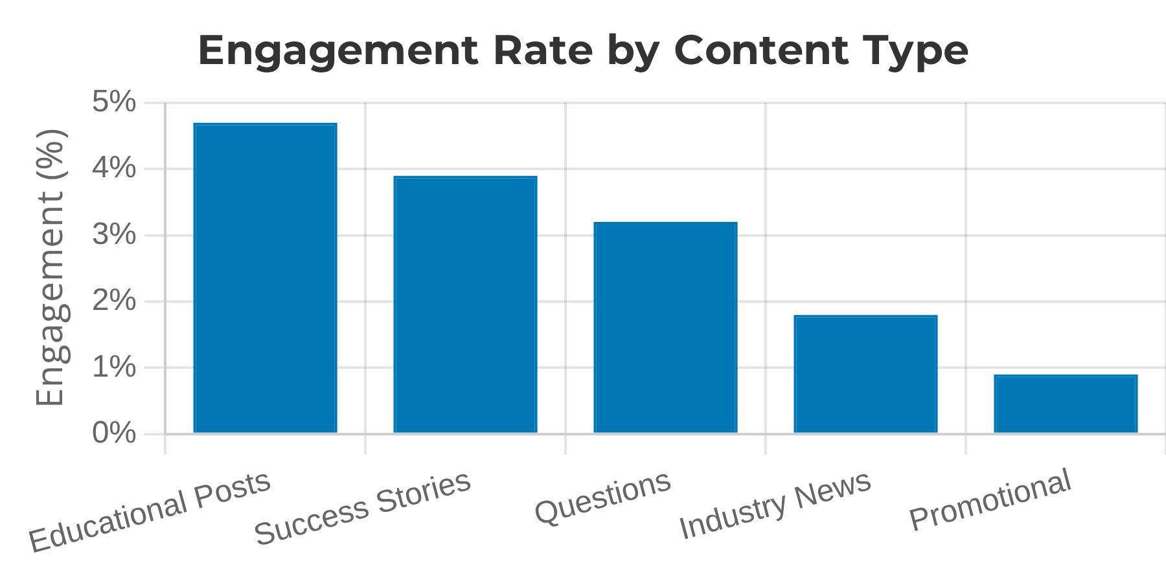
Strategic Content and Engagement
Attract prospects with relevant content
High-Engagement Post Examples
Educational Posts
JM
John Miller | B2B Sales Consultant
Share industry insights and practical tips.
🔑
3 questions that transformed my sales meetings:
1. "What's the biggest challenge your team is facing right now?"
Success Stories
2. "What happens if this problem isn't solved in the next 6 months?"
3. "How would you measure the success of a solution?"
Share concrete results and testimonials.
Simple, yet powerful. Try them! #B2BSales
347
52
28
Proactive Engagement
Comment and interact with prospects' content.
AM
Anna Martinez | Sales Director
📊
Case Study: How we increased sales by 43%
✅ 127 qualified leads in 60 days
✅ 18 new clients
✅ 380% ROI in the first quarter
Want to know how? Comment "yes" below! #B2B
512
98
45

Slide 8

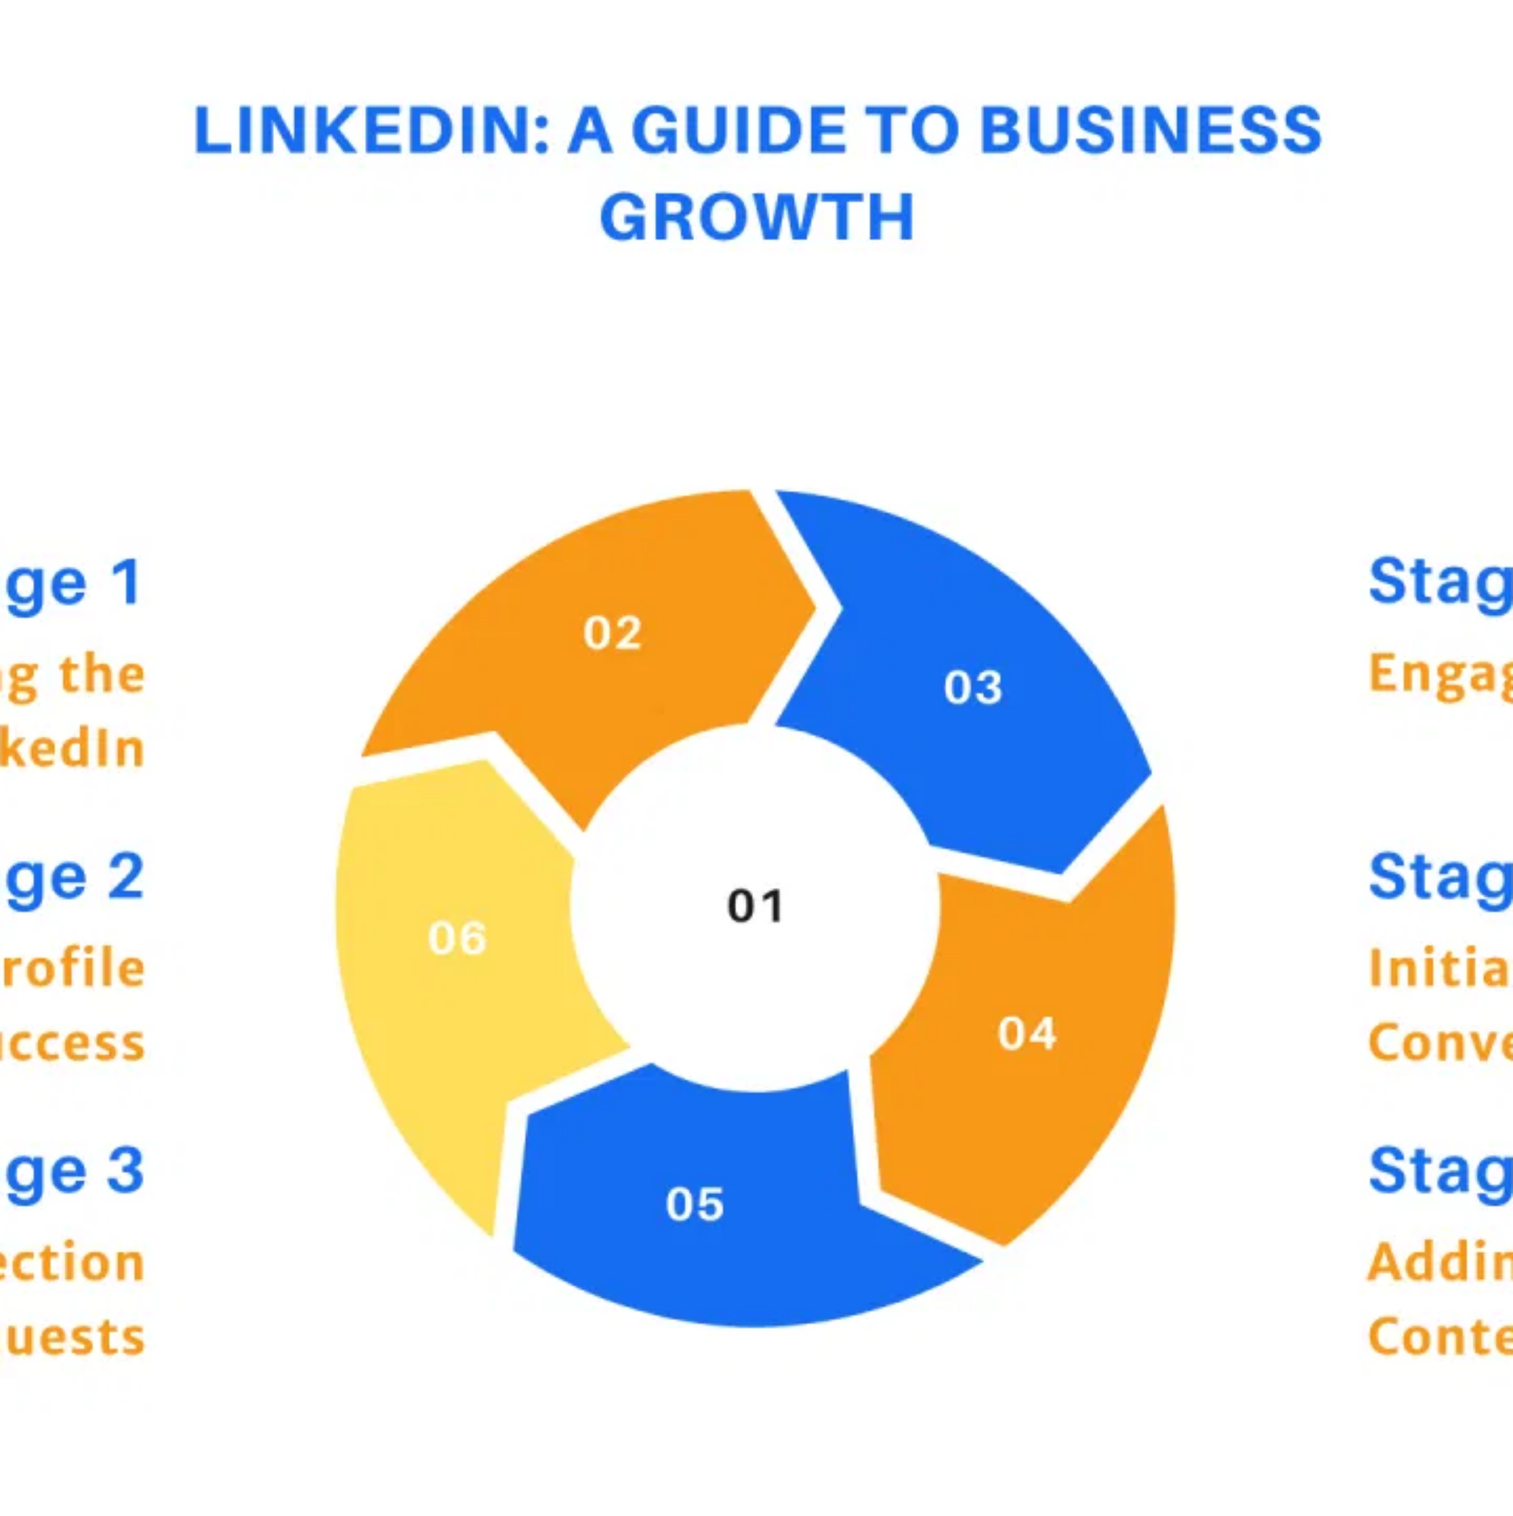





The LinkedIn Sales Funnel
From awareness to conversion
Stage 1: Awareness
Share educational and valuable content to increase visibility and establish authority in your niche.
Stage 2: Strategic Connection
Connect with qualified prospects using personalized messages based on mutual interests.
Stage 3: Engagement
Nurture relationships through genuine interactions, relevant comments, and sharing insights.
Stage 4: Conversion
Move the conversation to a meeting or demo, offering specific value for the prospect's challenges.
Stage 5: Retention and Referrals
Maintain active relationships and request recommendations and referrals to new prospects.

